Slide 1
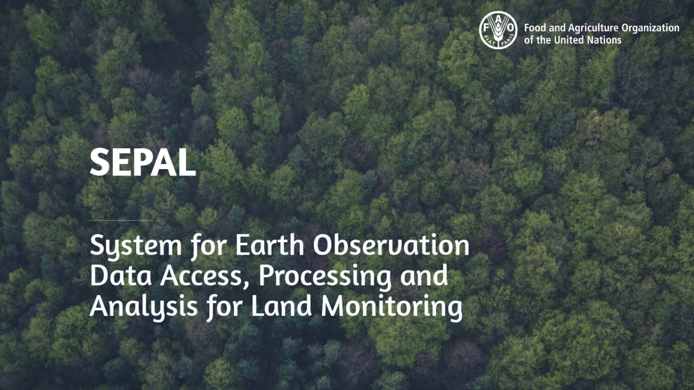

Slide 2
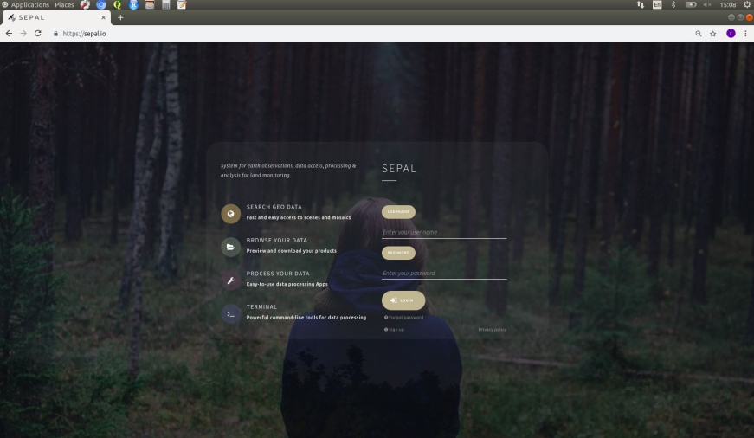
Cloud-based catalyst for autonomous land monitoring
@ sepal.io
Open source
Easy processing of earth observation data
Reduce time from innovation to adoption
Remove fear of making mistakes: fail fast

Slide 3



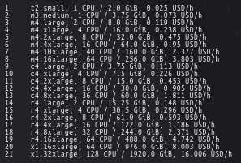


SEPAL functionnalities
Optical mosaics (Sentinel 2 and Landsat)
Supervised change detection
Thematic classification
Use you own processing chains on a powerful server
Segmentation
Object based analysis
Radar data processing
Sampling based analysis

Slide 4
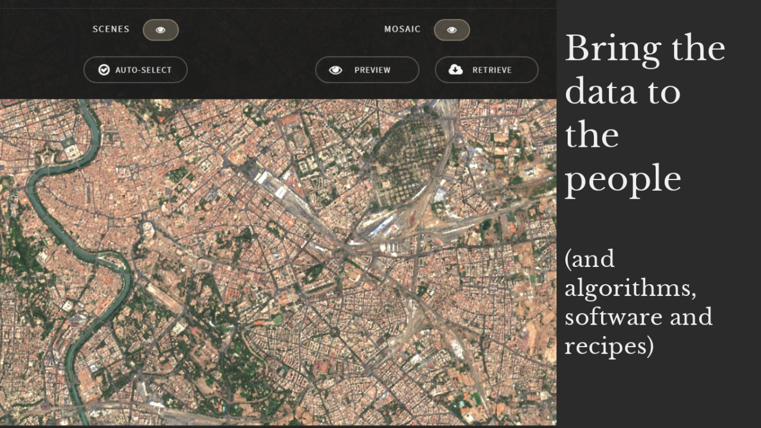

SEPAL
Bring the data to the people
(and algorithms, software and recipes)
www.fao.org/forestry

Slide 5
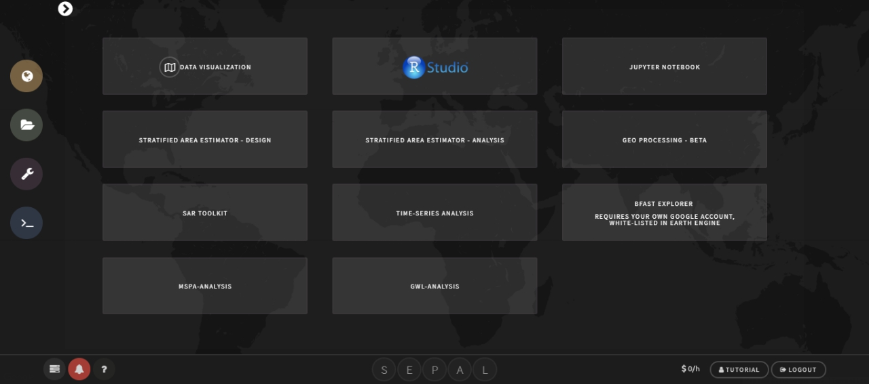
SEPAL Modules for Extended Capacity and Collaboration

Slide 6
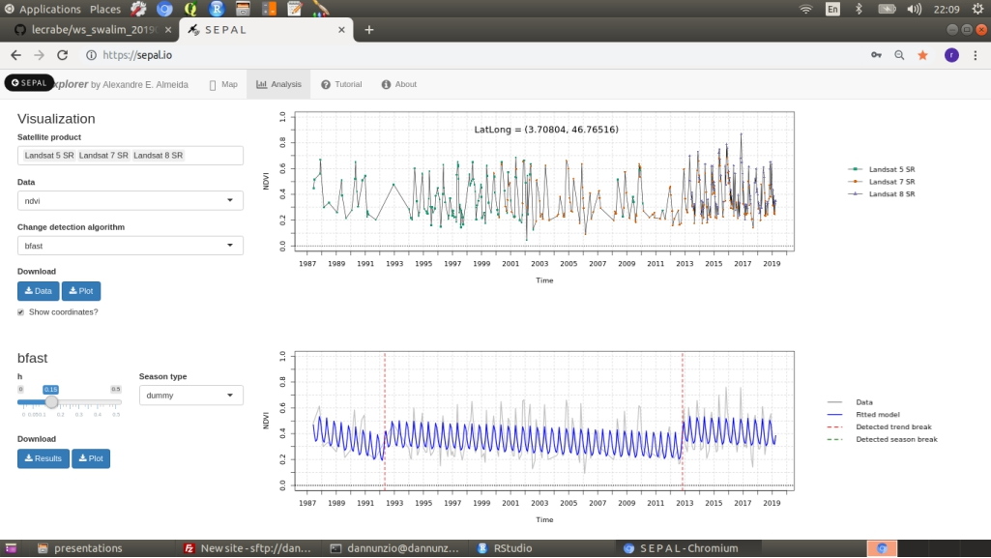
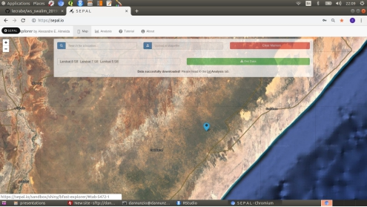
RSTUDIO SHINY: time series analysis of vegetation index

Slide 7
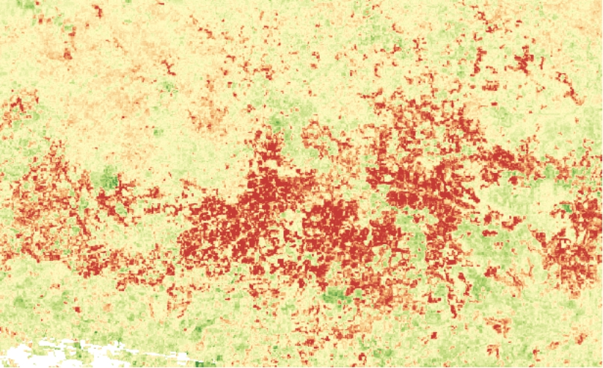
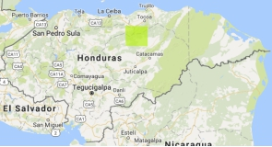
Landsat Time-series Analysis - Honduras Insect Damage
Every acquisition from 2010 - 2018 processed

Slide 8
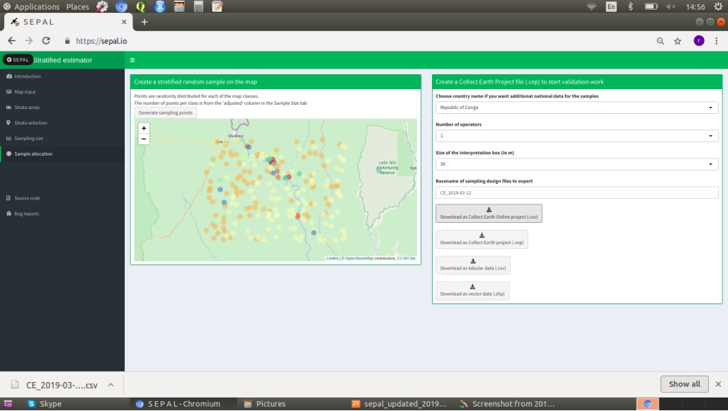
RSTUDIO SHINY: stratified area estimation from design to analysis

Slide 9
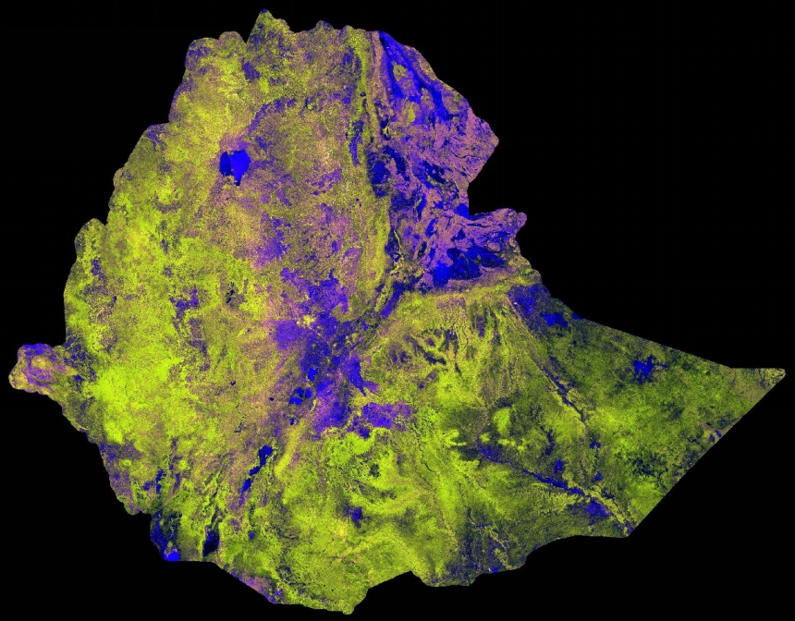
Analysis read mosaic of Sentinel 1 SAR data over Ethiopia
Andreas Vollrath

Slide 10
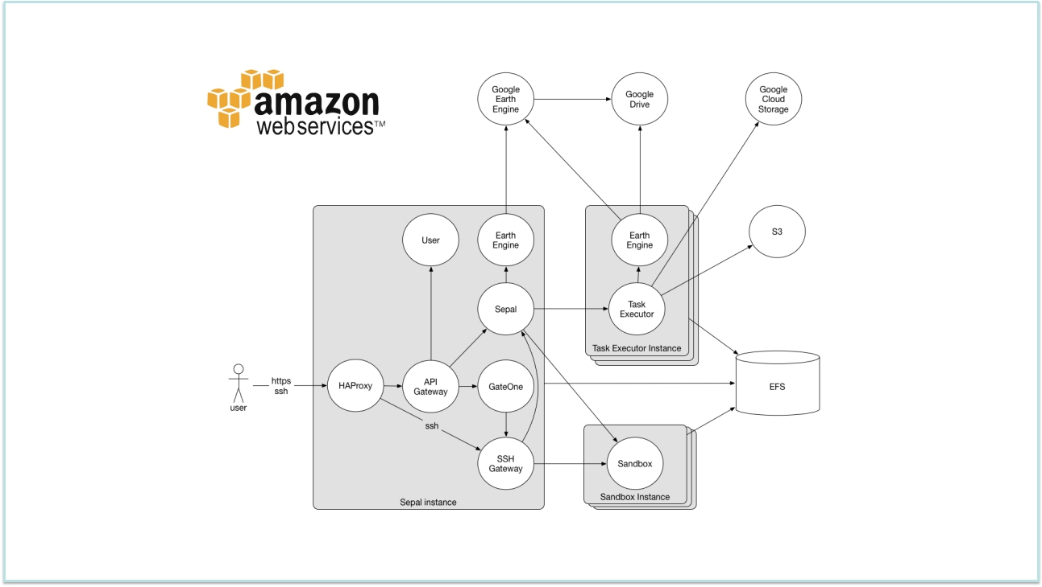

Slide 11
